Slide 1
Infotainment Privacy 101
Why syncing your phone to a rental car could put your data at risk
Security Awareness Training 2025

Slide 2
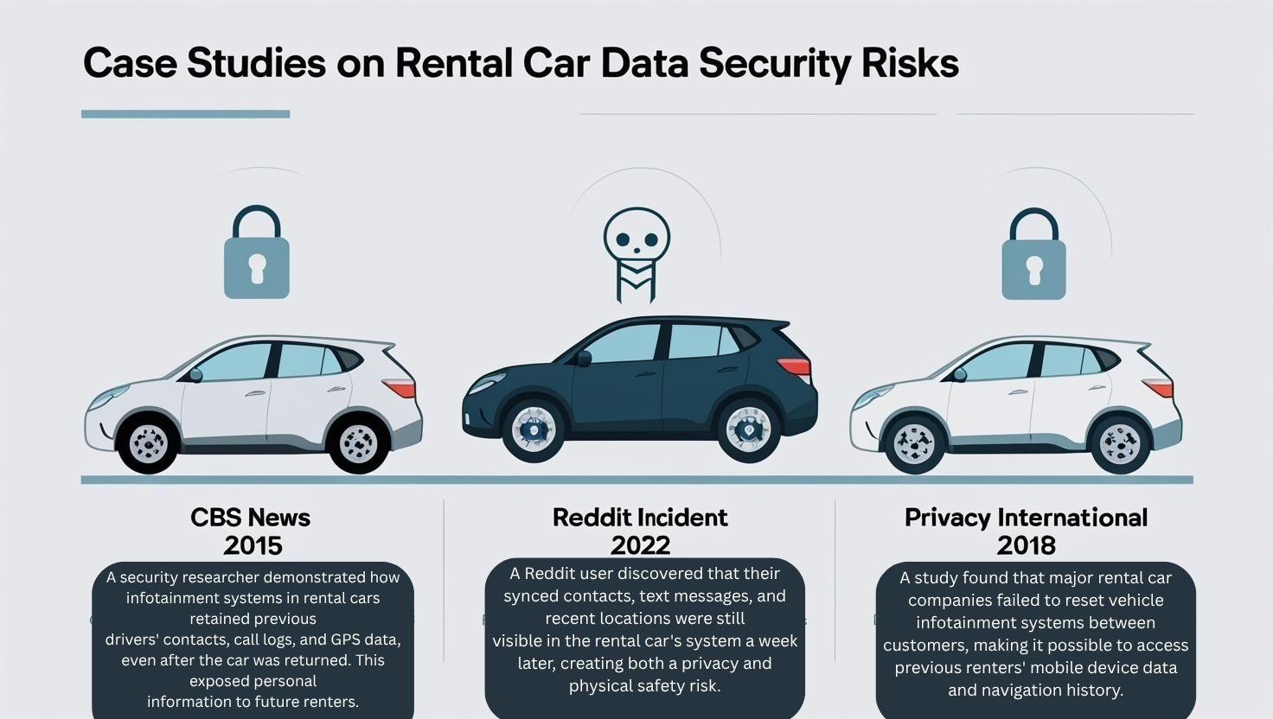
Real World Risk Example

Slide 3

How to Protect Your Data
Avoid syncing your phone to any rental car infotainment system.
Use Bluetooth in “hands-free” mode without contact sharing.
Follow the company’s Data Deletion Checklist before returning the car.

